Slide 1
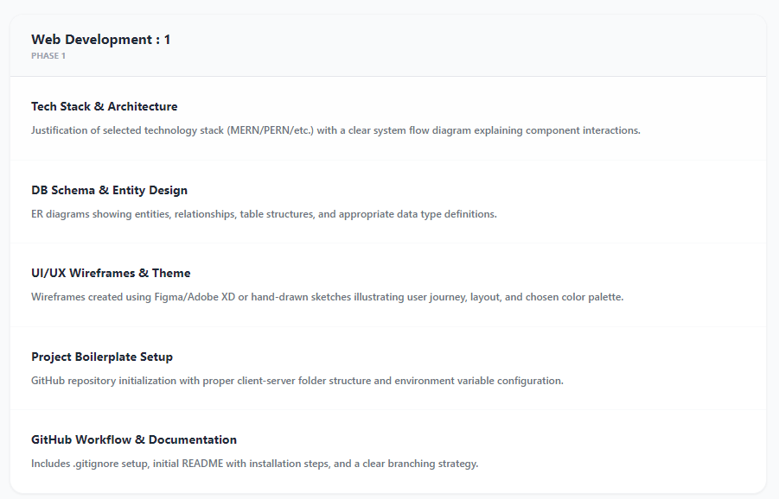
REVIEW – PHASE 2
DIGITAL PROCESS BENCHMARKING TOOL
PRESENTED BY
ASHOK J
[7376241EC502]
PBL BASED FULLSTACK PROJECT
DEPT. : ELECTRONICS & COMMUNICATION ENGINEERING
DATE : 12/02/2026

Slide 2
TECH STACK & SYSTEM ARCHITECTURE
This project uses the MERN stack for fullstack web development.
FRONTEND
React.js is used to build the user interface
Provides interactive and dynamic UI
BACKEND
Node.js is used as runtime environment
Express.js is used to create APIs
DATABASE
MongoDB is used to store user and benchmarking data
This stack provides scalability, flexibility, and fast performance.

Slide 3
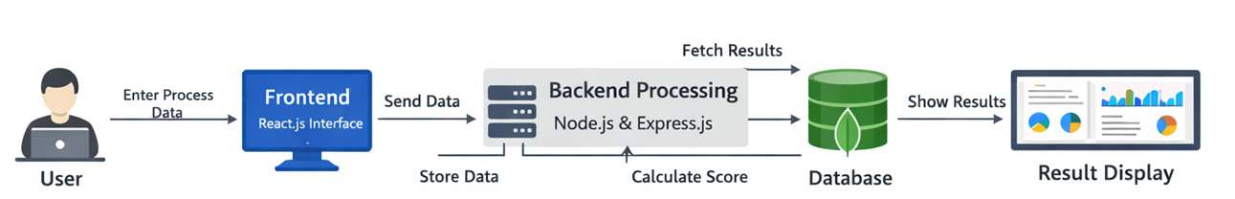
ARCHITECTURE DIAGRAM
Explanation:
• User enters benchmarking data in frontend • Frontend sends data to backend through API • Backend processes data • Backend stores data in MongoDB database • Backend calculates benchmarking score • Results sent back to frontend • Frontend displays results in dashboard

Slide 4
DB SCHEMA & ENTITY DESIGN
MongoDB is used as the database.
Main Entities:
1. User Entity: • userId • name • email
2. Benchmark Entity: • benchmarkId • processName • userScore • benchmarkScore • result
Relationship: User provides benchmarking data, which is stored and compared with benchmark values.

Slide 5
DATABASE STRUCTURE
Collections used:
Users Collection • Stores user details
2. Benchmark Collection • Stores process scores • Stores benchmark comparison
This structure ensures efficient data storage and retrieval.

Slide 6
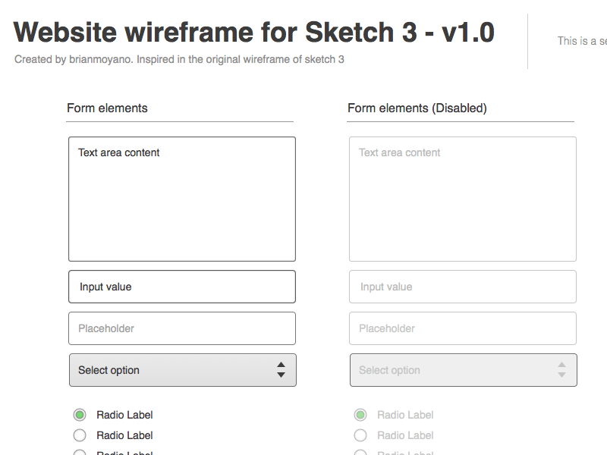
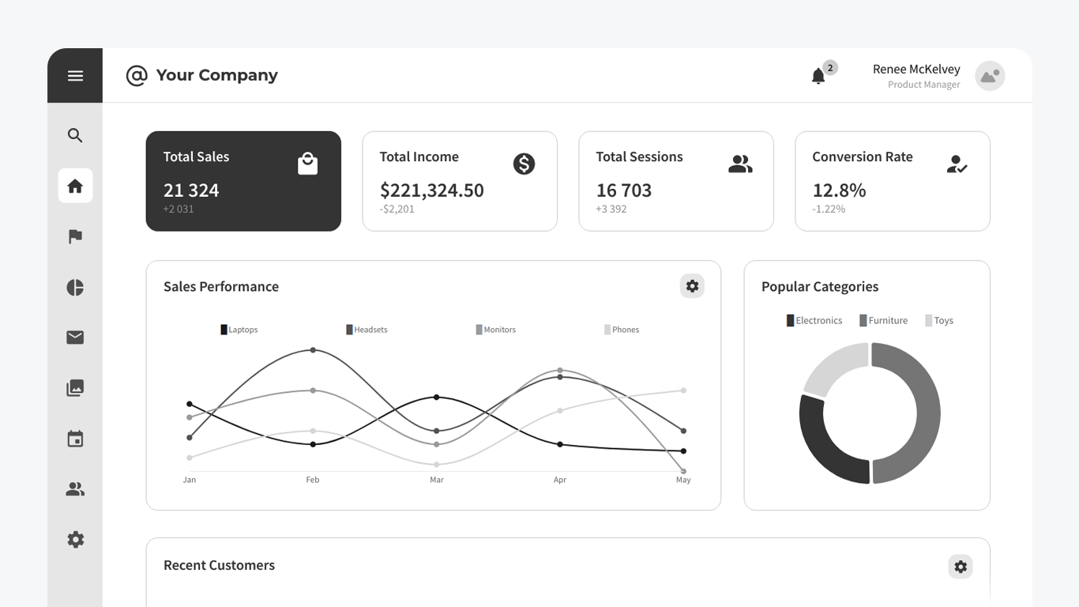
UI/UX WIREFRAMES & THEME
Wireframes were designed to plan the user interface.
Main Screens:
• Home Page • Data Entry Form • Dashboard Page • Result Display Page
Theme:
• Simple and professional design • Easy navigation • User-friendly interface
Wireframes help visualize the system
before development.

Slide 7
PROJECT BOILERPLATE SETUP
Project structure created using MERN stack.
1. Frontend setup:
• React.js project initialized • Folder structure created
2. Backend setup: • Node.js project initialized • Express server created
3. Database setup: • MongoDB connected
Folder structure includes:
• frontend folder • backend folder • database connection

Slide 8
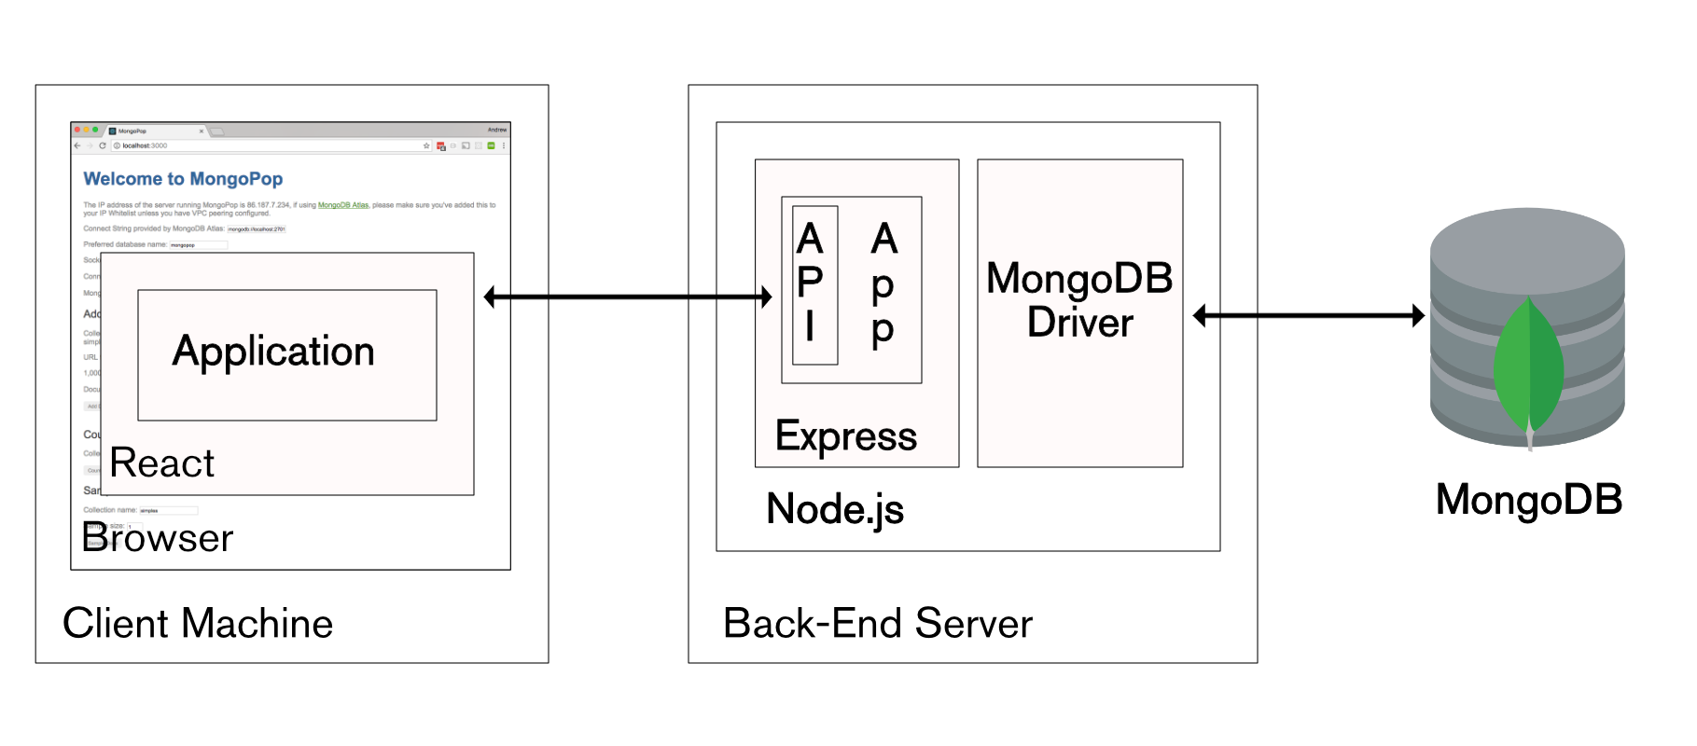
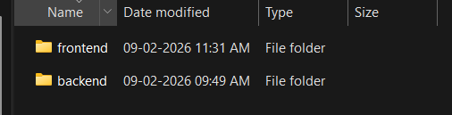
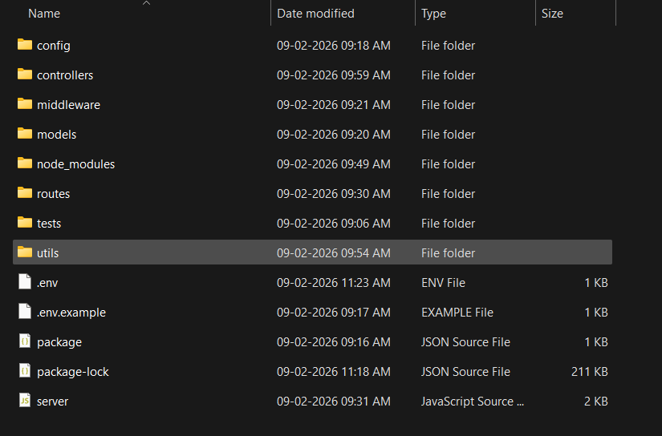
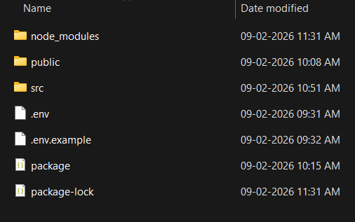
PROJECT FOLDER STRUCTURE
PROJECT FILE DIRECTORY
BACKEND
FRONTEND

Slide 9
GITHUB WORKFLOW & DOCUMENTATION
GitHub repository created for project.
GitHub includes:
• Project source code • Proper folder structure • README file • Installation instructions
README contains:
• Project description • Technologies used • Steps to run project
Git helps track and manage project development.

Slide 10
CURRENT PROGRESS
Completed:
• Technology stack selection • Architecture design • Database schema design • Wireframe planning • Project setup (frontend and backend) • GitHub repository created
In Progress:
• API development • Frontend development

Slide 11
FUTURE PLAN & CONCLUSION
Next steps include:
• Complete frontend development
• Complete backend APIs
• Implement benchmark logic
• Create dashboard
• Testing and deployment
Conclusion:
The Digital Process Benchmarking Tool is designed using MERN stack architecture. The system structure, database design, and project setup have been successfully completed. Further development will focus on implementing core benchmarking functionality.

